Slide 1
Time Series

Slide 2
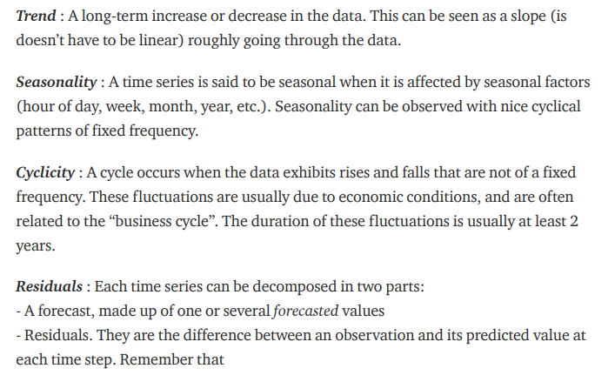
Time Series - Component

Slide 3
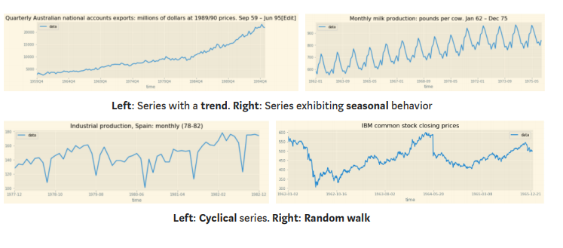
Time Series - Component

Slide 4
Time Series - Stationarity
Stationarity refers to the system whose underlying statistical properties do not change with time, it means that time series will follow a particular behavior in the future too.
It is important that the Series is stationary because working and operating upon Stationary data is much simpler.
Mean should be constant – It conveys that there is no trend in the Time Series.
Variance should be constant – It conveys that there is no heteroscedasticity (difference in the variance of a variable across the different intervals of time in the same data).
Autocorrelation should be constant – To remove randomness among the data and make a constant pattern relationship.
No Periodic component – It means that there is no seasonality

Slide 5
Test to Check Stationarity
1. Summary Statistics
Summary statistics is basically to review the statistical properties of our data.
We can divide our data into the number of small portions and then apply Statistics like mean and variance to see if they lie in a close range or differ too much.
data_array = np.array(data[‘Stock'])
partitions = np.split(data_array, indices_or_sections=5)
print(“---- Partitions Mean")
np.mean(partitions, axis=1)
print("-"*30)
print(“----- Partitions Variance ")
np.var(partitions, axis=1)

Slide 6
Test to Check Stationarity
2. Histogram Plot
Plot a histogram graph and if the shape or the graph closely represents a Normal distribution Curve we can confirm that data has stationarity .
data_array = np.array(data[‘Stock'])
pd.Series(data_array).hist()

Slide 7
Test to Check Stationarity
3. Augmented Dickey-Fuller (ADF) Test
ADF test is a statistical test and these types of tests can provide confirmatory evidence that your time series is stationary or non-stationary. ADF test checks for stationarity by using a hypothesis. We may wither accept or reject this hypothesis.
Null Hypothesis – The null hypothesis is accepted and it suggests that the time series is non-stationary.
Alternate Hypothesis: The null hypothesis is rejected and it suggests the time series is stationary.
Generally, the threshold value is 5%.
P-Value < 0.05 – Null hypothesis rejected and Time-Series is Stationary.
P-Value > 0.05 – Null hypothesis accepted and Time Series is Non- Stationary.

Slide 8
Convert Stationary to Non-Stationary
Log Transformation
Differentiating

Slide 9
Time Series - Component

Slide 10
Time Series - Component

Slide 11
Time Series - Component

Slide 12
Time Series - Component

Slide 13
Time Series - Component

Slide 14
Time Series - Component

